Slide 1
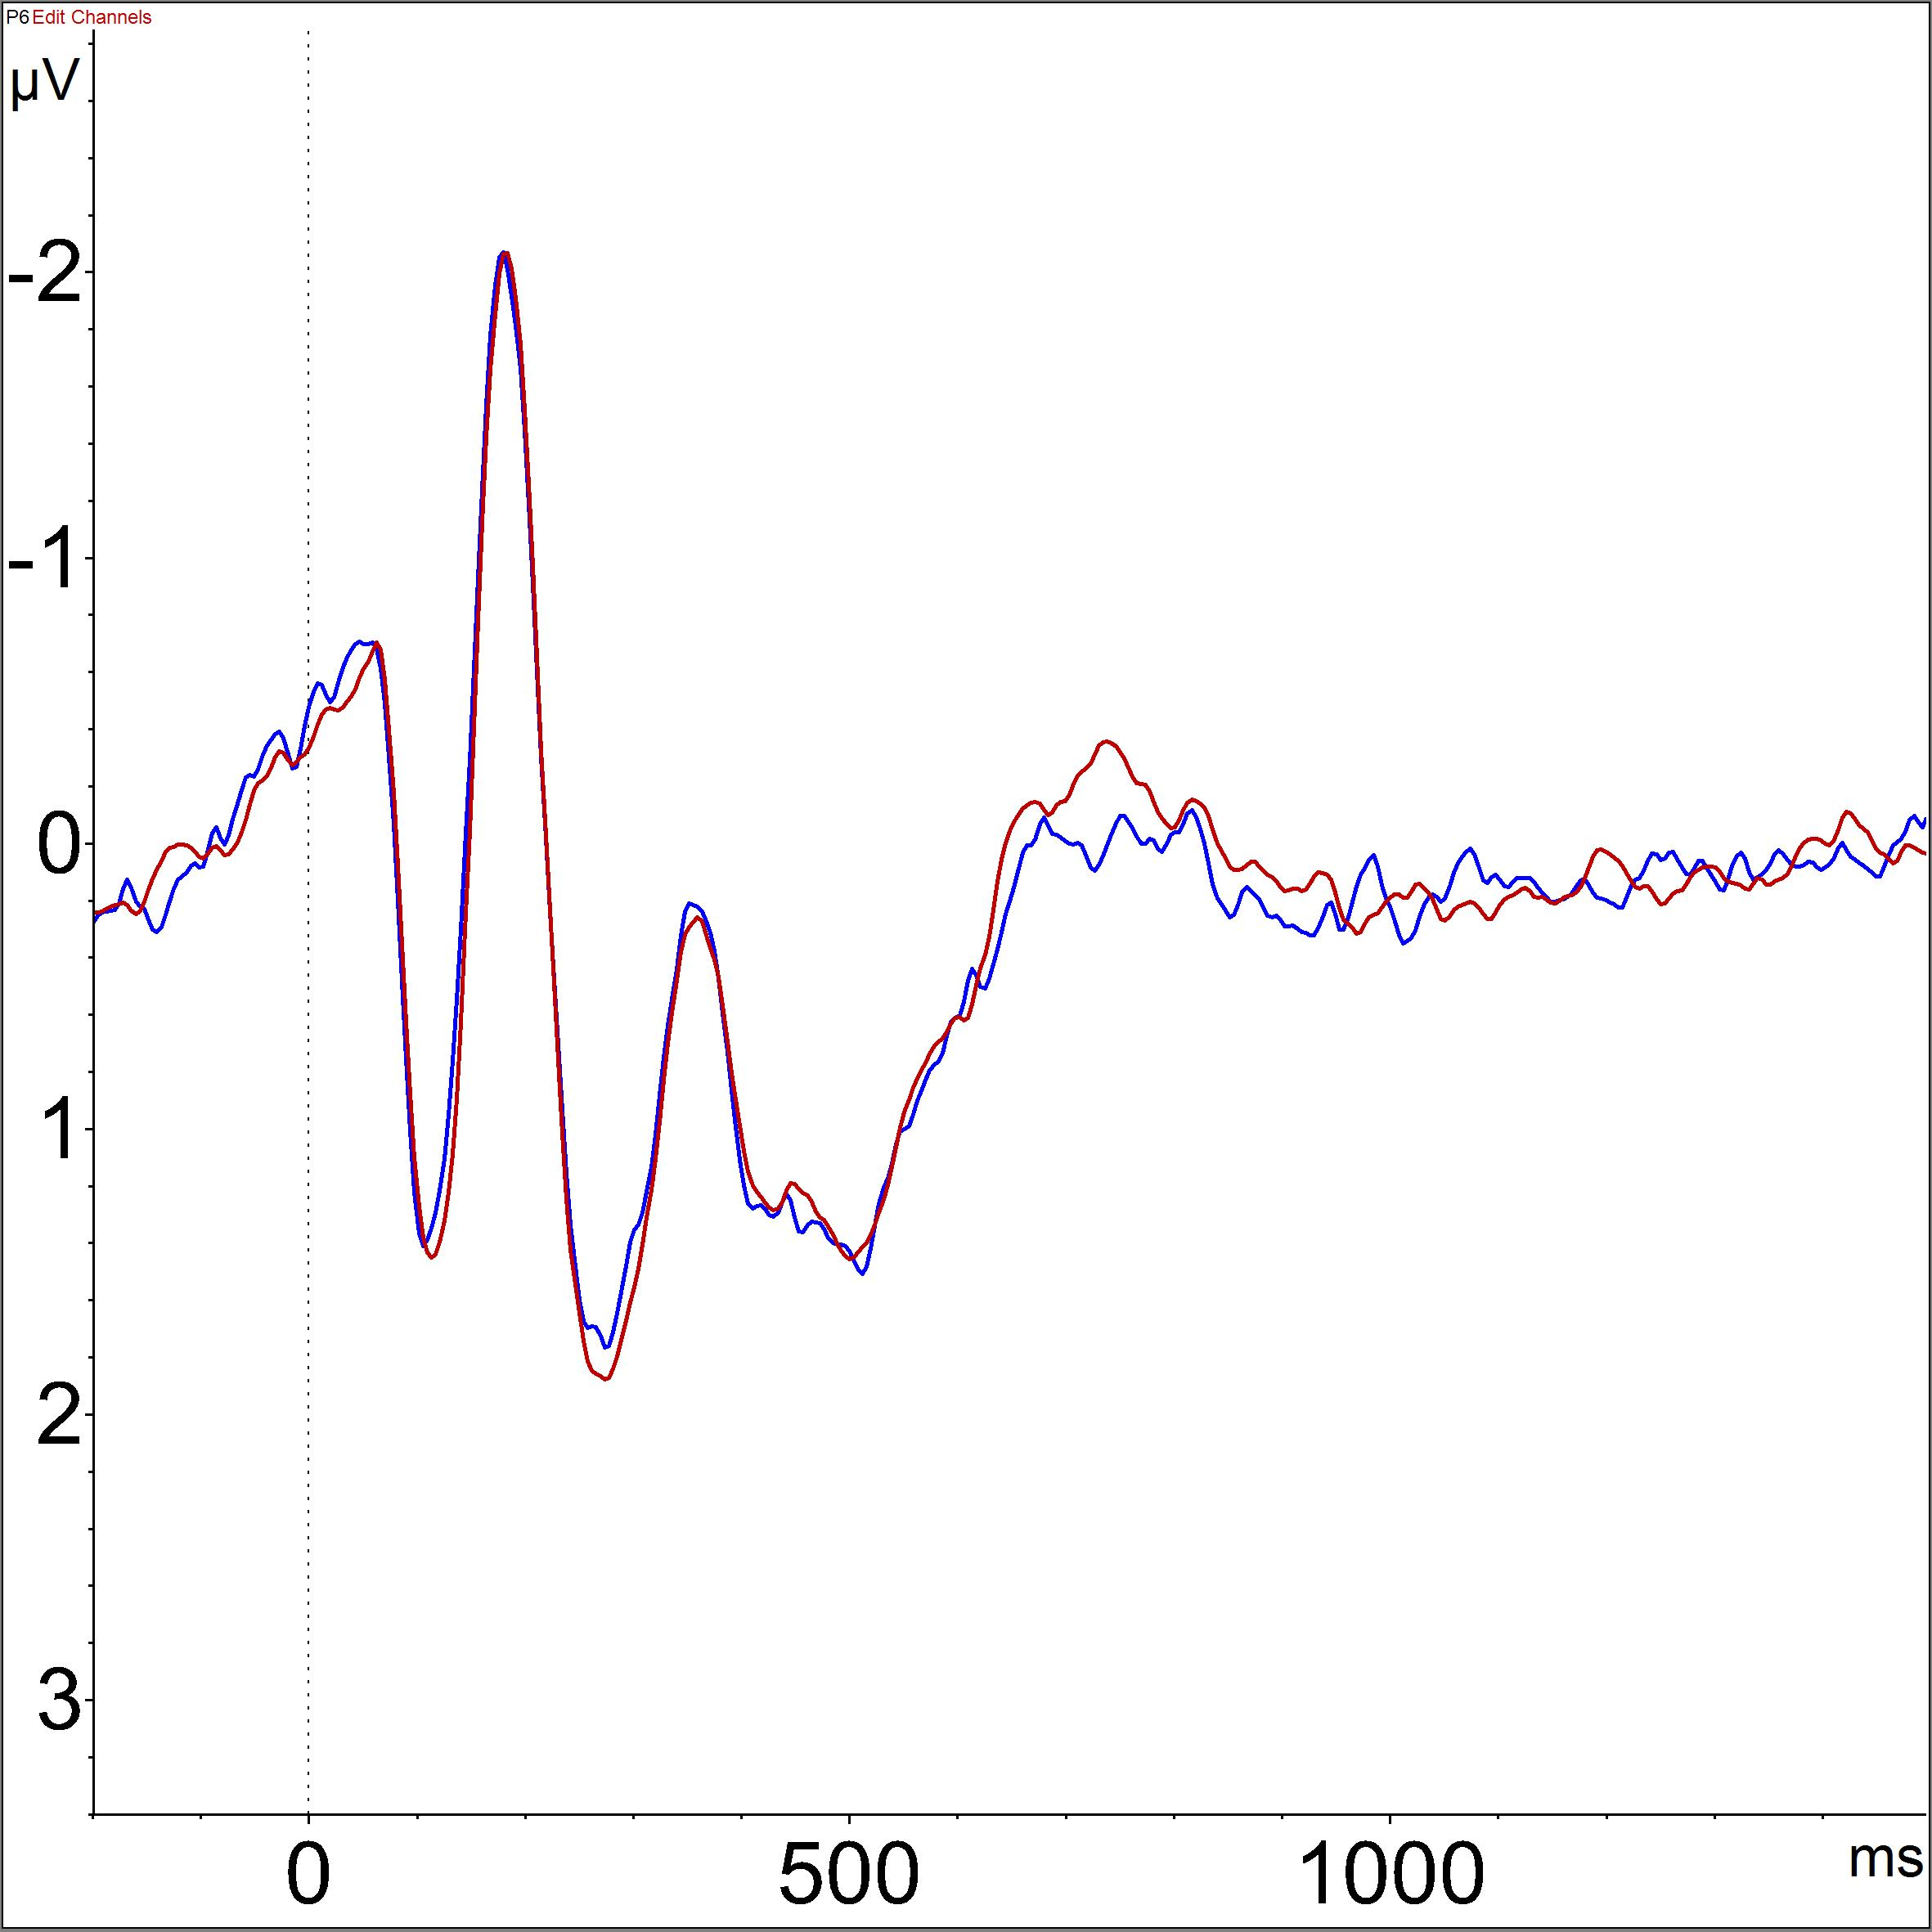
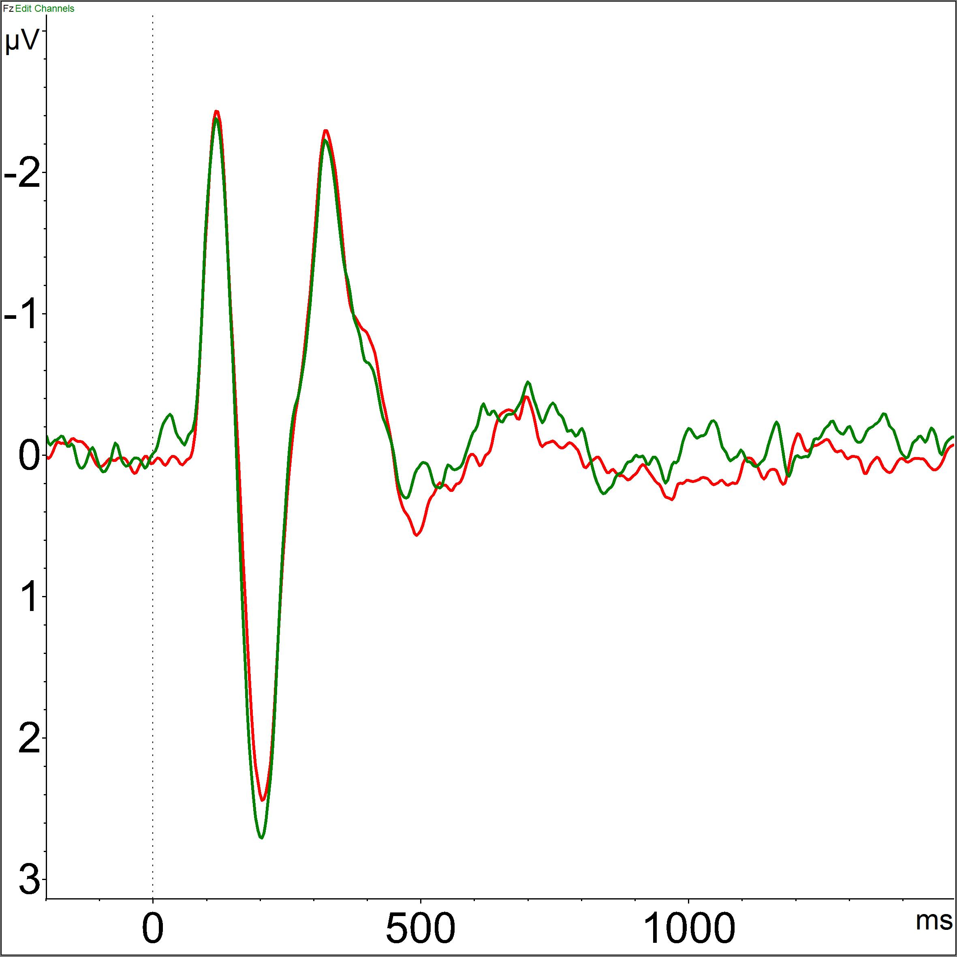
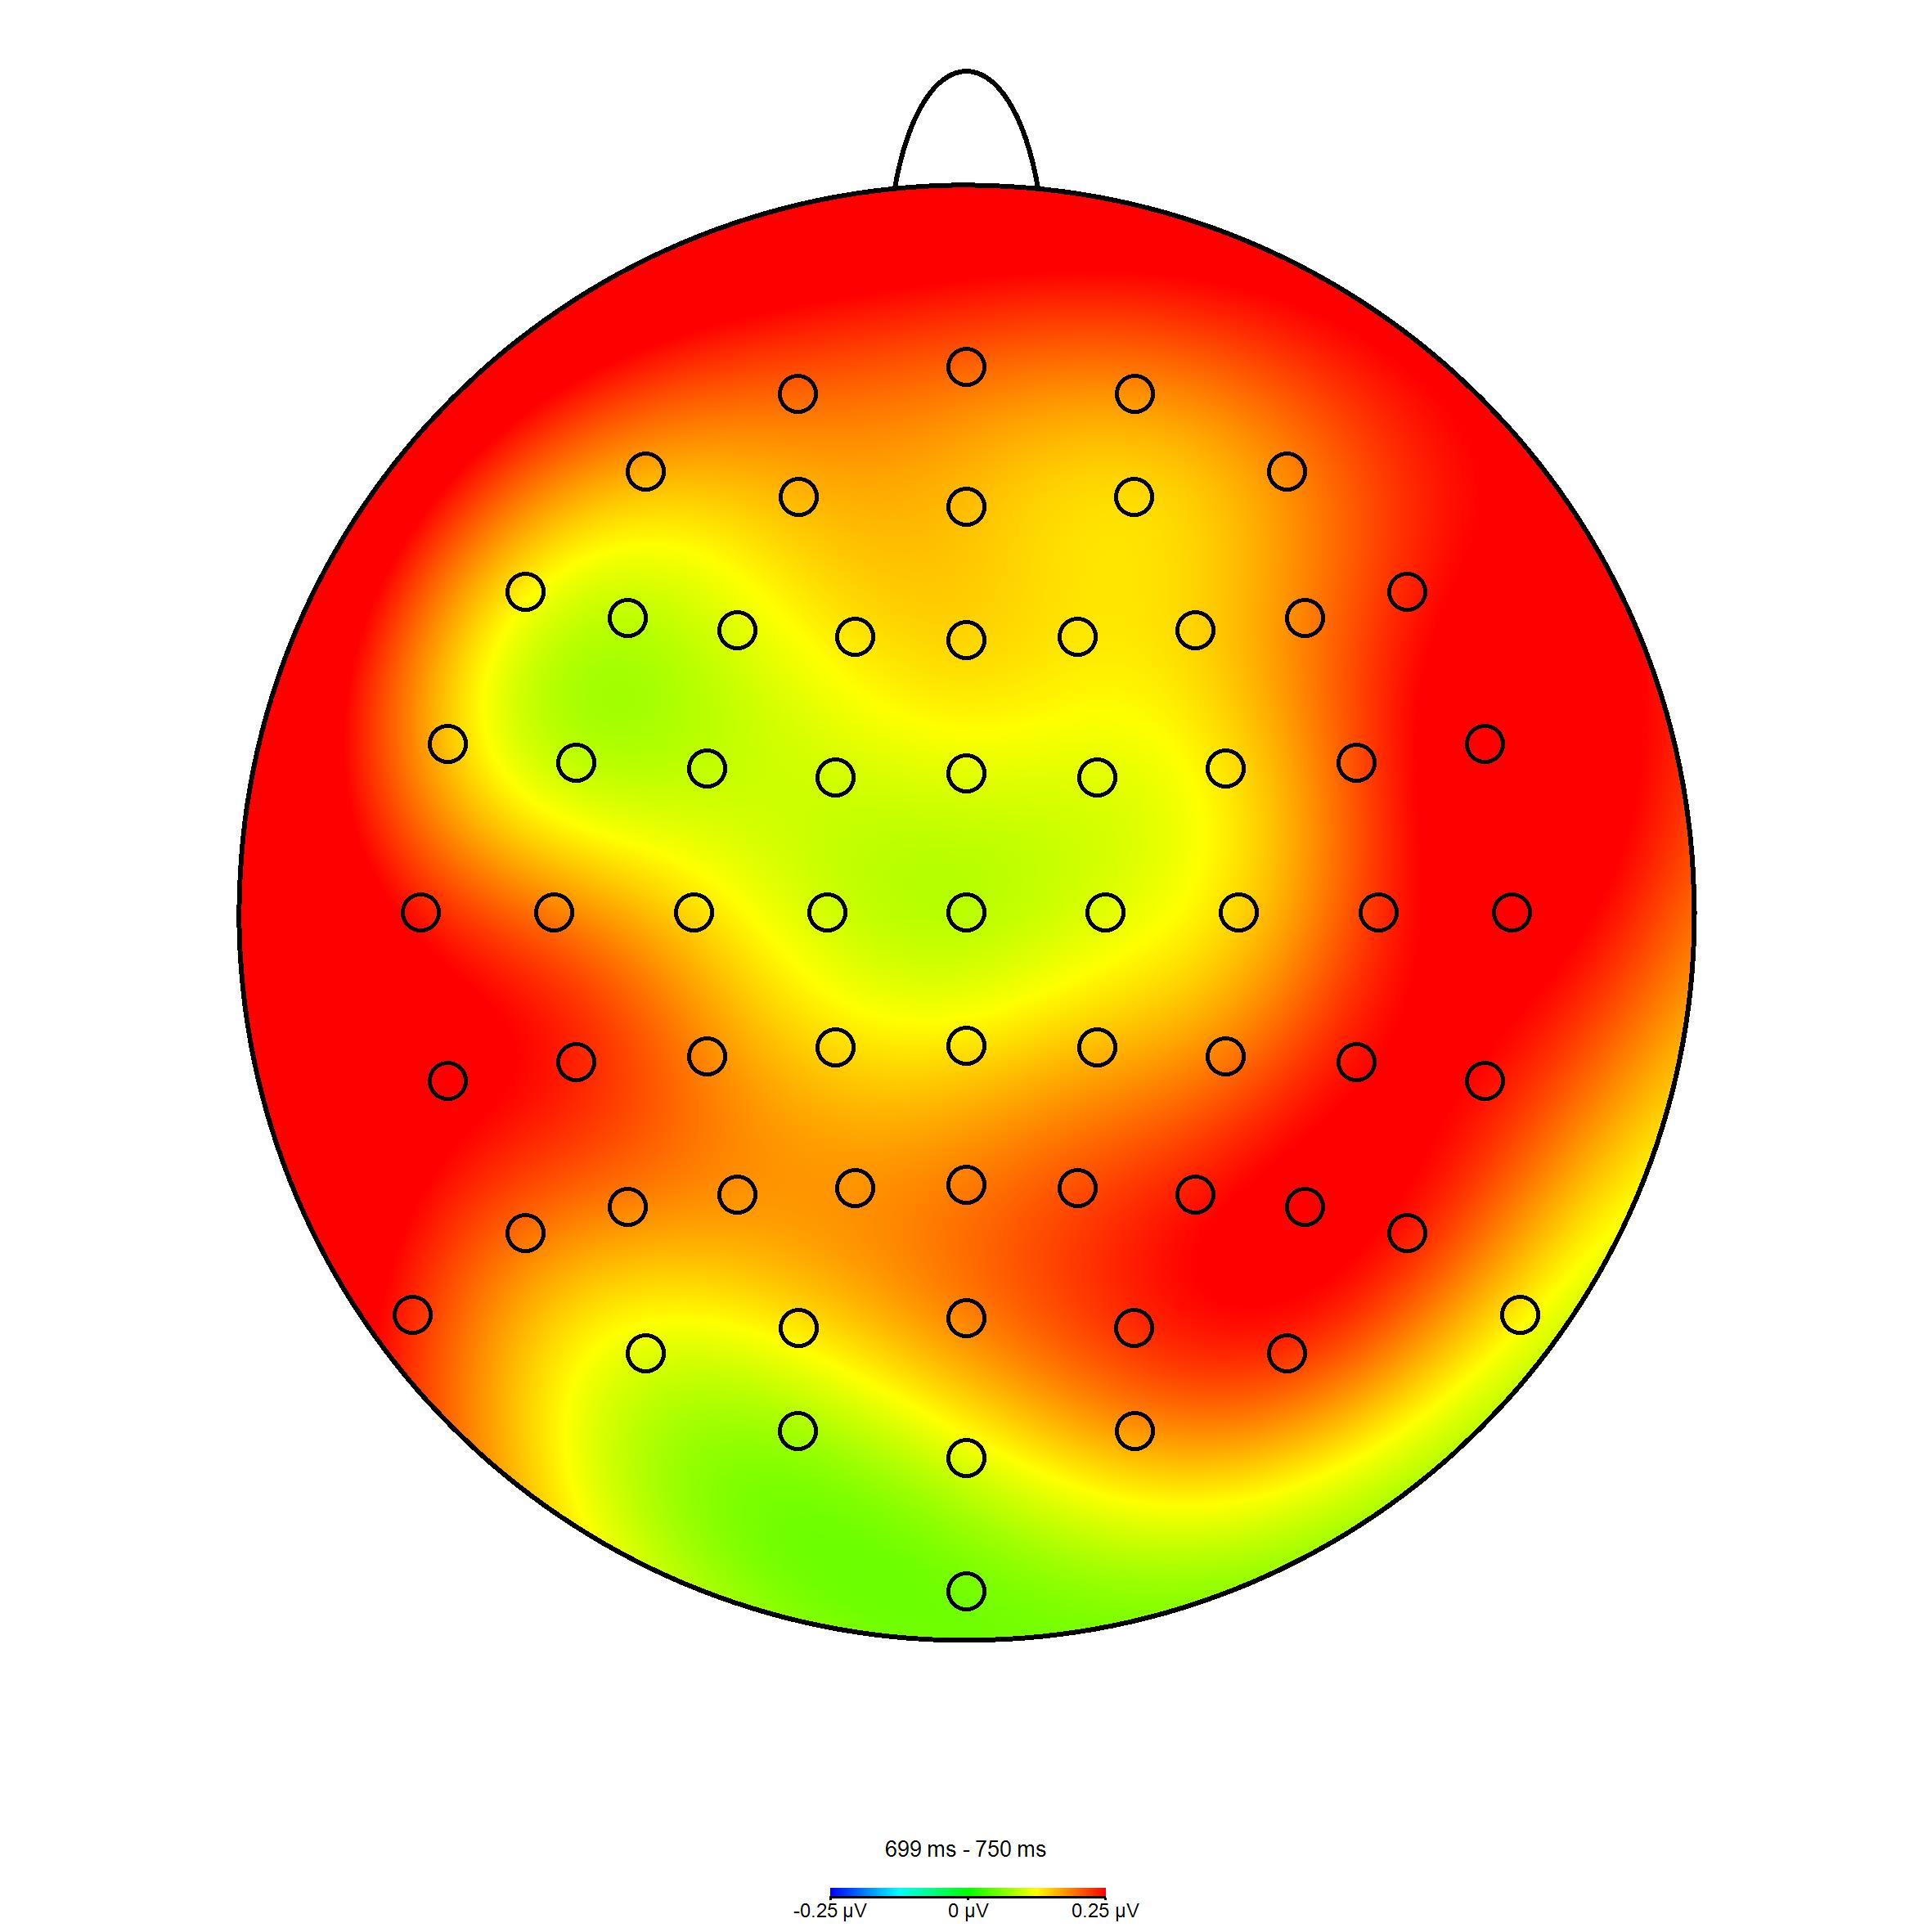
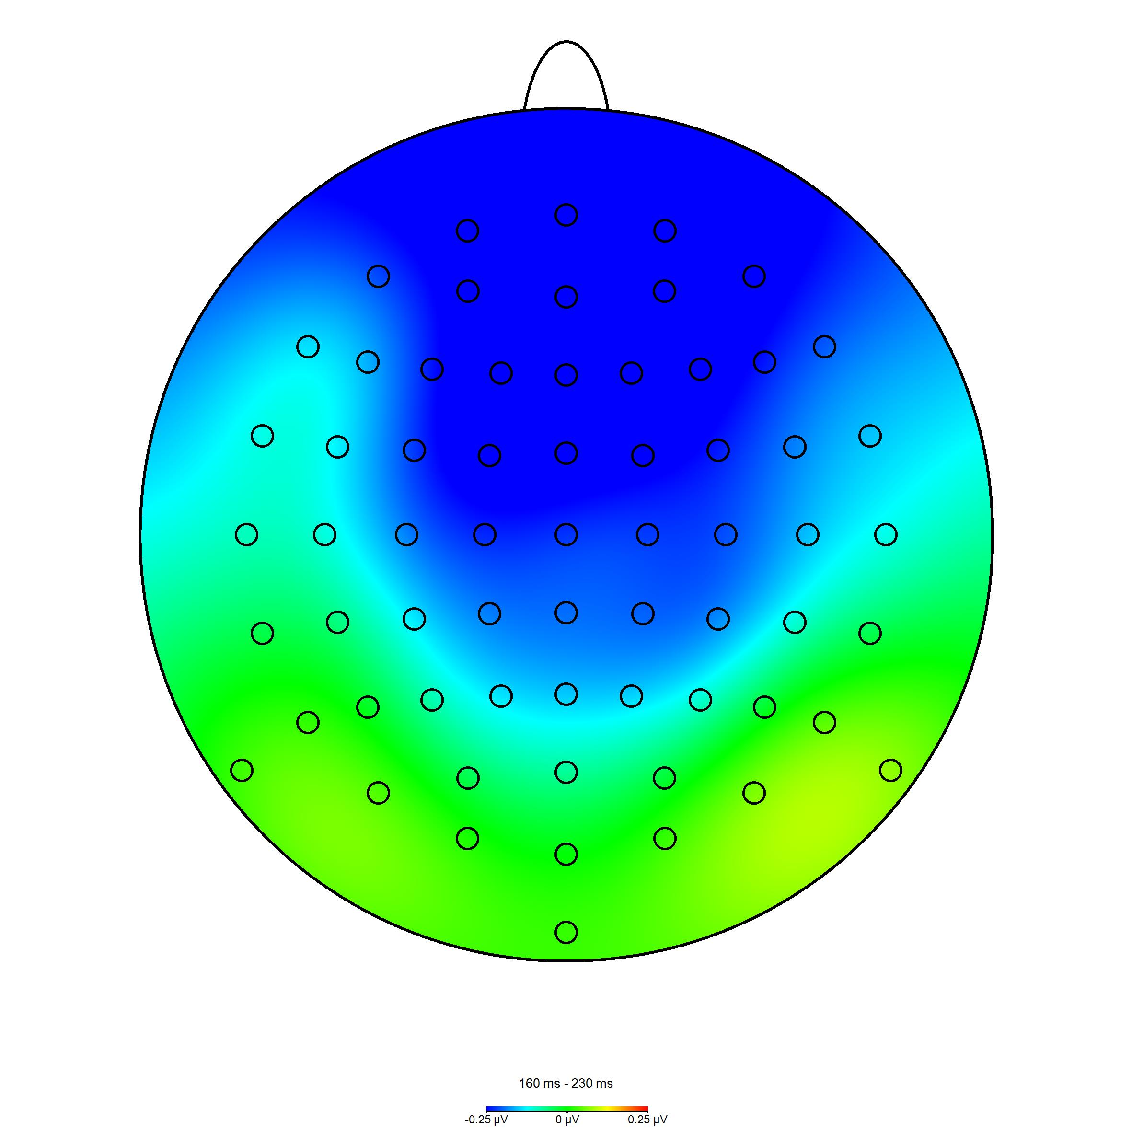
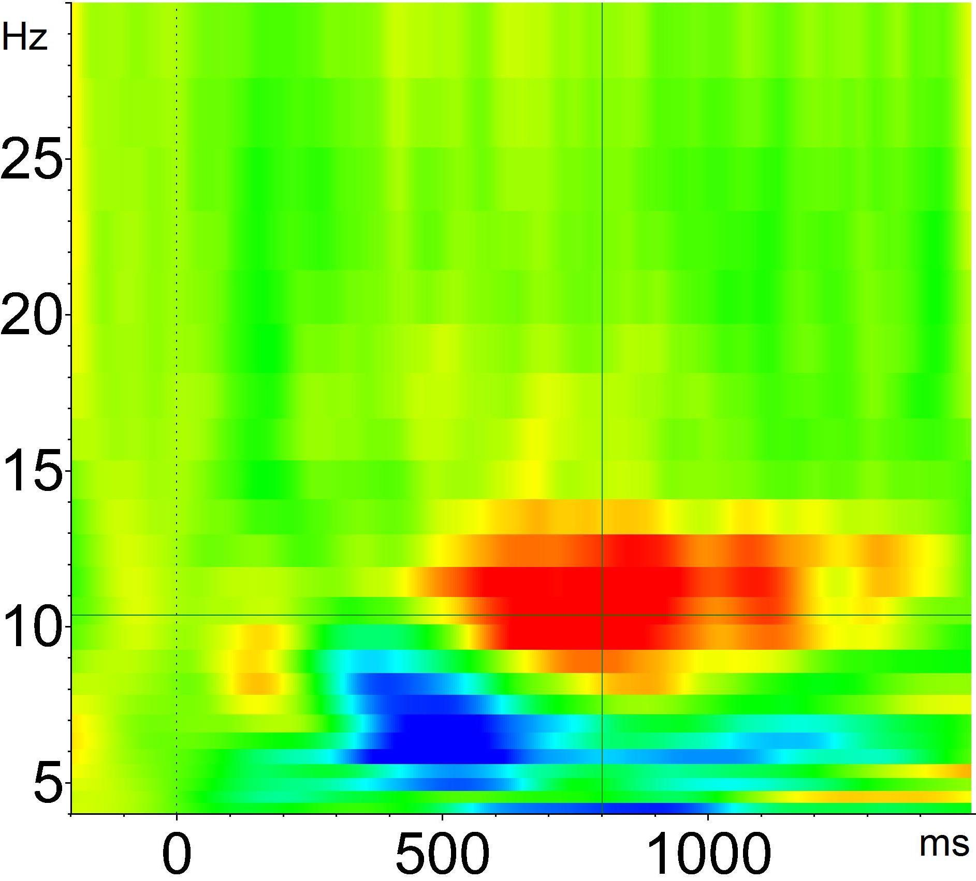
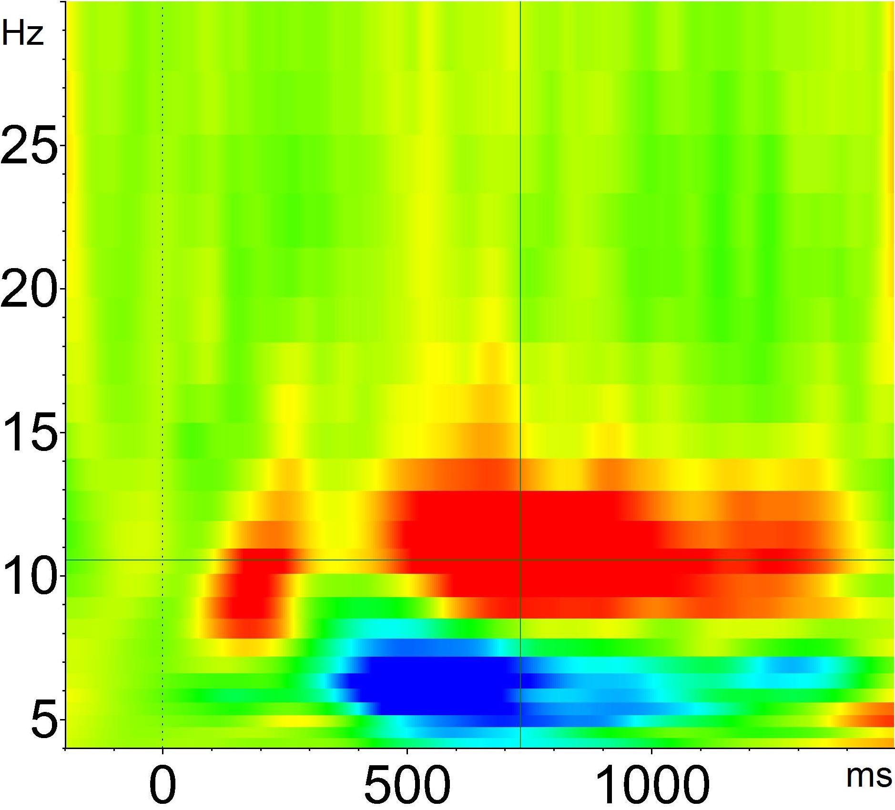
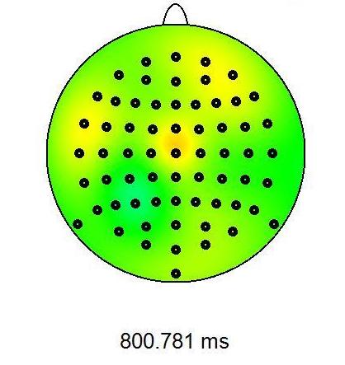
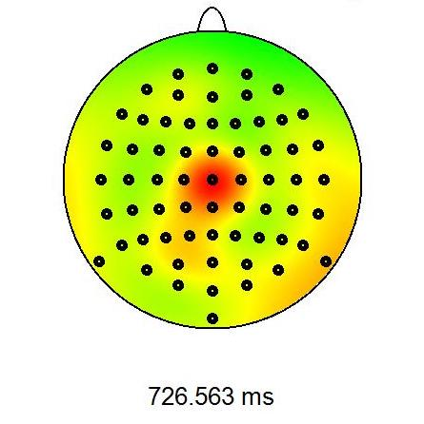
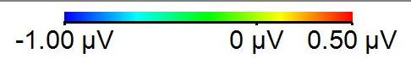




Event-Related Brain Responses to Lexical Encoding Exposures Predicts Subsequent False Endorsement of Orthographically Related Lures
Nicholas R. Griffin, Bersabeh Asfaw, Toby Brans, David Marquez, Samuel Weyser, Catarina Yee, David M. Schnyer
The University of Texas at Austin
Introduction
Differences in subsequent memory (Dm) effects describe neurophysiological differences during encoding for items later remembered versus items later forgotten¹.
In veridical Dm memory tests, positive posterior ERP components are shown to be more positive for later remembered items than later forgotten items¹.
In the current study, we were interested in investigating Dm effects for false memory using a word-learning paradigm.
We tested participants with a range of depressive symptoms and reported mood states in an orthographic adaptation of the DRM false memory paradigm^{2,3,4}.
To test Dm effects for subsequent false memory, we averaged ERPs during encoding, for encoded words associated with later false alarm endorsements and encoded words associated with later correct rejection endorsements (Associate Dm, or ADm).
With the current study, we aim to address the following points:
Behavioral Results
Significantly greater gamma for novel words than critical lures (F_{(1,55)} = 13.60, p < .001, μ_{p}² = .08), and negative vs. neutral unlearned items (F_{(1,55)} = 13.04, p< .001, μ_{p}² = .06).
Significantly greater criterion for negative vs. neutral items (t_{(1,55)} = 3.39, p = .001, 95% CI = [0.05, 0.21]).
Using mixed linear regression models, controlling for CESD score differences (screening v. test), we examined whether CESD or PANAS predict test responses.
EEG Recording
64 channels of continuous EEG, plus one electrode on each mastoid.
Four electrodes placed to monitor electrooculargraphic (EOG) activity (vertical and horizontal eye movement).
A BioSemi II amplifier, impedances kept within the recommended ±40mv operating range.
ERP Results
Pointwise Non-Parametric Randomized Permutation Analysis⁷
Significance threshold determined for each location & time point. Thresholds from estimated t-distribution from 20000 random permutations under H₀. Locations of sig. t-values used to determine clusters of significant activation differences.
Type I Error Correction: 20000 permutations to determine null distribution of clusters exceeding significance. Exceedance mass for each cluster computed.
Use exceedance masses to determine truly sig. clusters against non-permuted clusters in standard max step down correction of null distribution. Clusters w/ mass > p = .05 are considered significant.
Dm: Cortical activity during encoding predicting subsequent test performance.
ADm: Cortical activity during encoding predicting responses to unlearned words associated with previously encoded words.
Significant Hit Dm/FA ADm cluster 685-750ms post-stimulus onset, maximal from 700-750ms - more positive ERP for subsequent correct vs. false item endorsements.
Significant FA ADm/CR ADm cluster 160-230ms post-stimulus onset - potentially more effective early item encoding for words associated with subsequent correct rejections⁸.
Dm ERPs not significantly predicted by PANAS Negative Affect score.
Spectral Power Analyses
Dm for Hits vs.
ADm for False Alarms (FA)
ADm for False Alarms (FA) vs. ADm for Correct Rejections (CR)
Whether differences in cortical activity are evident for encoded words associated with later false alarms and correct rejections.
Whether these differences in cortical activation correlate with measures of depressive symptoms or mood state.
Figure 4. Overall hit rate by valence.
Figure 5. Overall false alarm rates by valence and type of unlearned item.
No difference in hit rate by valence.
Significantly more false alarms for neutral vs. negative lures, (F_{(1,55)} = 25.31, p < .001, μ_{p}² = .14), and critical lures vs. novel items, (F_{(1,55)} = 311.05, p <.001, μ_{p}² = .23).
Methods
Participants
56 adults, fluent English speakers. 24 females, 32 males (mean age = 19.8, SD = 1.1).
Participants completed Positive and Negative Affect Schedule (PANAS)⁵ (mean = 19.3, SD = 6.46) and Center for Epidemiologic Studies Depression scale (CESD)⁶. Scores ≥ 16 = High CESD (max = 60). Low CESD at screening: n = 21; at test: n = 12.
Encoding
Each block: 4 lists assoc. with neutral, 4 lists assoc. with negative lures.
LIST WORDS ONLY (64 words per block; 32 assoc. with each valence).
Recognition Test
16 List Words: 2 randomly selected from each encoding block.
16 Novel Items: 8 Associated Critical Lures + 8 Novel Words.
Confidence ratings following each trial (4-Point scale).
**
P6
Fz
**
**
Figure 10. Head maps and local ERP averages showing post-stimulus activation differences at significant cluster.
Figure 11. Head maps and local ERP averages showing post-stimulus activation differences at significant cluster.
Orthographic Associates
Figure 6. Gamma scores by item type and valence.
Figure 7. Criterion by valence.
deer
+
Book
Look
Cook
Pail
Pair
Main
Dm for Hits vs.
ADm for Correct Rejections
ADm for False Alarms vs.
ADm for Correct Rejections
3s
link
0.5s ISI
+
hoof
Cz
Cz
3s
Figure 1. Illustration of the encoding sequence.
0.5s ISI
3s
Critical Lures:
Repeated Words
Novel:
Orthographic Associates
Figure 12. Event-related EEG frequency distribution,
4-30 Hz: ADm CR – Dm Hits.
Figure 13. Event-related EEG frequency distribution,
4-30 Hz: ADm CR – ADm FA.
Figure 14. Difference in alpha power (ADm CR – ADm FA; Frequency * Time) by PANAS Negative Affect.
Hook (neutral)
Book
Look
Paint (neutral)
Pain (negative)
Pail
Pair
Malice (negative)
Trend for greater alpha power (10-12 Hz; 700-900ms post-stim.) for items associated with subsequent CR than subsequent Hits (t_{(1,55)} = 1.88, p = .066, 95% CI = [67.83, -2.19]).
Significantly greater alpha power (10-13 Hz; 650-800ms post-stim.) for items associated with subsequent CR than subsequent FA (t_{(1,55)} = 2.81, p= .007, 95% CI = [7.89, 47.19]).
Trending negative correlation between difference in ADm CR and ADm FA alpha power and PANAS Negative Affect (r = -0.23, p = .09, 95% CI = [-0.46, 0.04]).
Figure 2. Examples of orthographic associates with associated critical lures (shown at test).
Figure 8. Overall false alarms to novel items by PANAS Negative Affect and valence.
Figure 9. High confidence false alarms to critical lures by PANAS Negative Affect and valence.
--- Lures
Significant interaction of novel words false alarms: increases as a function of PANAS, and greater for neutral than negative items (t_{(1,52)} = 2.27, p = .026).
For high confidence responses, false alarm rate to critical lures rate increases as a function of PANAS Negative Affect, (t_{(1,52)} = 2.27, p = .026).
List
Words
Discussion
PANAS significantly predicts increased false alarms, indicating that state-dependent factors like mood may predict increased memory distortion.
Differences in ERPs between subsequent memory for hits and associated false alarms mirror prior Dm literature; encoding advantage for subsequent correct responses.
Like prior research, alpha power during encoding increases as test performance increases⁹; here, correct versus incorrect responses to non-encoded items.
While the ERP results suggest universal encoding effects across all participants, the spectral analyses suggest a potential effect of state-dependent negative bias during encoding on subsequent false memory outcomes.
Neutral Associate Lists
Negative Associate Lists
Neutral
Novel Items
for Test:
Negative
Figure 3. Representation of test design, with blocking example.
References
Paller, K. A., & Wagner, A. D. (2002). Observing the transformation of experience into memory. Trends in cognitive sciences, 6(2), 93-102.
Roediger, H. L.,&McDermott, K. B. (1995). Creating false memories: Remembering words not presented in lists. Journal of experimental psychology: Learning, Memory, and Cognition, 21(4), 803.
Pesta, B. J., Murphy, M. D., & Sanders, R. E. (2001). Are emotionally charged lures immune to false memory?. Journal of Experimental Psychology: Learning, Memory, and Cognition, 27(2), 328.
Piguet, O., Connally, E., Krendl, A. C., Huot, J. R.,& Corkin, S. (2008). False memory in aging: Effects of emotional valence on word recognition accuracy. Psychology and aging, 23(2), 307.
Watson, D., Clark, L. A., & Tellegen, A. (1988). Development and validation of brief measures of positive and negative affect: the PANAS scales. Journal of personality and social psychology, 54(6), 1063.
Radloff, L. S. (1977). The CES-D scale a self-report depression scale for research in the general population. Applied psychological measurement, 1(3), 385-401.
Nichols, T. E., & Holmes, A. P. (2002). Nonparametric permutation tests for functional neuroimaging: a primer with examples. Human brain mapping, 15(1), 1-25.
Dunn, B. R., Dunn, D. A., Languis, M.,& Andrews, D. (1998). The relation of ERP components to complex memory processing. Brain and cognition, 36(3), 355-376.
Klimesch, W., Doppelmayr, M.,&Hanslmayr, S. (2006). Upper alpha ERD and absolute power: their meaning for memory performance. Progress in brain research, 159, 151-165.
Scan here for copy of the poster

